Slide 1
The Methylotrophs
They use compounds with one or more carbon atoms but no C-C bonds as their sole source of carbon and energy: Methane, Methanol , methylamine, dimethylamine.
Those that use methane are also called Methanotrophs (eg. Methylococcus, Methylosinus)
Obligate methylotrophs cannot grow on multicarbon compounds (include most methanotrophs)
Facultative methylotrophs also grow on multicarbon compounds (eg. Methylobacterium extorquens = Pseudomonas AM1
Restricted facultative methylotrophs grow on C1 or C2 compounds (eg. Hyphomicrobium)
Facultative autotrophs grow on carbon dioixide, plus hydrogen or methanol by way of RuBP path (eg Paracoccus)
There is a huge number of different types of methylotroph. Very few are typical bacteria that had been described previously. Although their oxidative metabolism is basically similar, there are many different carbon assimilation pathways.
Most are Gram-negative. The few Gram positive methylotrophs (Bacillus sp) have different oxidation enzymes
1906 Sohngen. Bacillus methanicus growing on methane
Peel and Quayle. Pseudomonas AM1 (cited only 6 papers) A pink facultative methyltroph
1964 Anthony and Zatman. Description of Methanol dehydrogenase in Pseudomonas M27 (=AM1)
1964 Hirsch and Conti. Hyphomicrobium. A stalked facultative methylotroph
Whittenbury (with Wilkinson). 100 new methanotrophs (2 Types)
Ribbons Early work on methane oxidation
1970- Ogata, Sahm, Hazeu, van Dijken, Harder. Methylotrophic yeast.
1980 Dalton Definitive work on methane oxidation
1982 Anthony book. Cited about 1200 methylotroph references

Slide 2
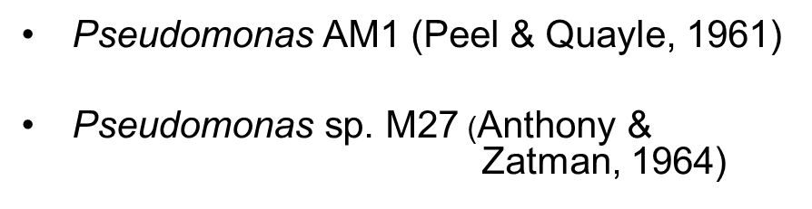
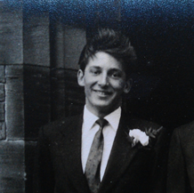
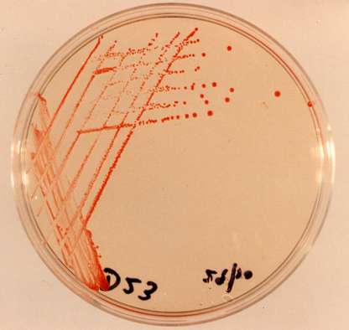
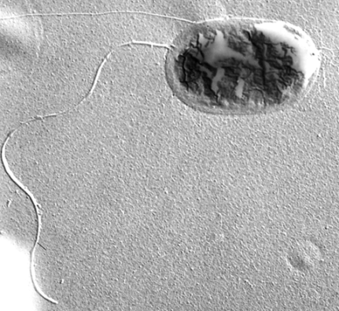
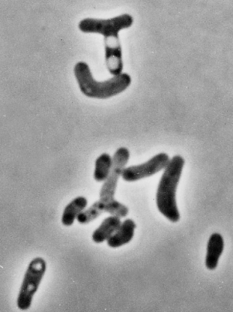

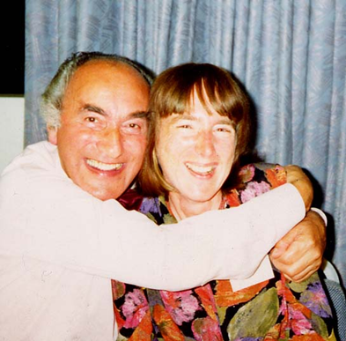

The main ‘workhorses’ in the study of methylotrophs
Methylobacterium extorquens. A pink facultative methylotroph
Me in 1963
J Rod Quayle
My PhD supervisor and my first research student (Len Zatman and Pat Dunstan, now Goodwin)
Howard Dalton, Rod and me

Slide 3
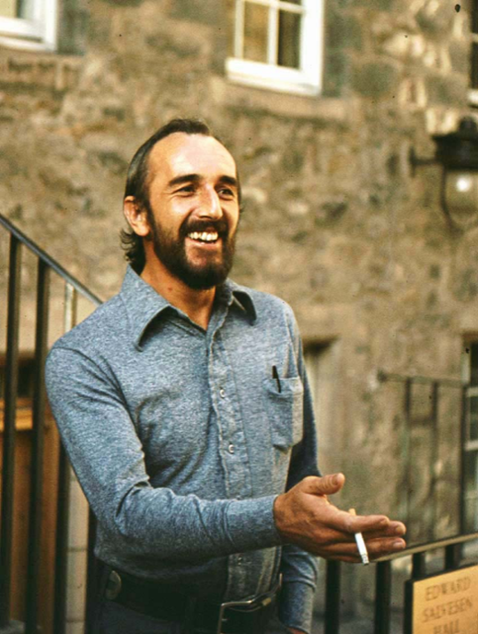
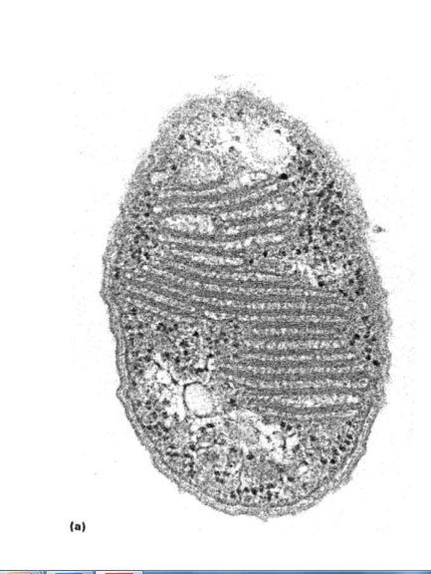
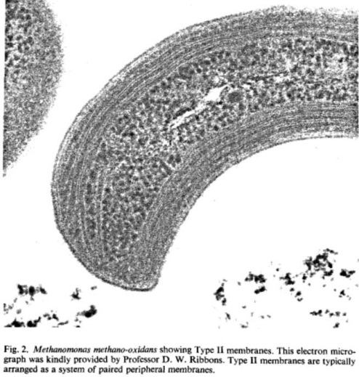


Methylococcus capsulatum (Type I obligate methanotroph)
Methylosinus trichosporium (Type II obligate methanotroph)
Type I membranes
Type II membranes
Doug Ribbons 1973

Slide 4
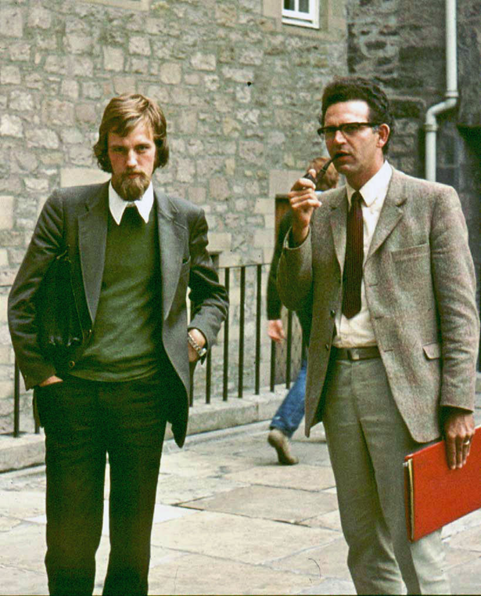
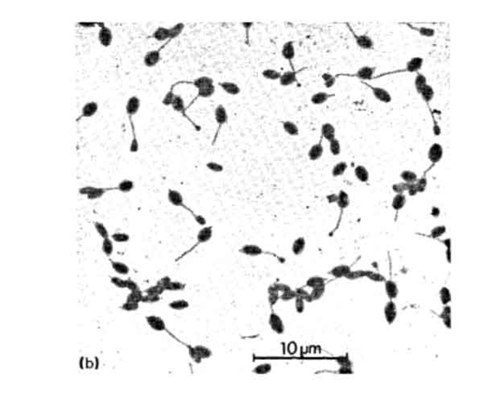
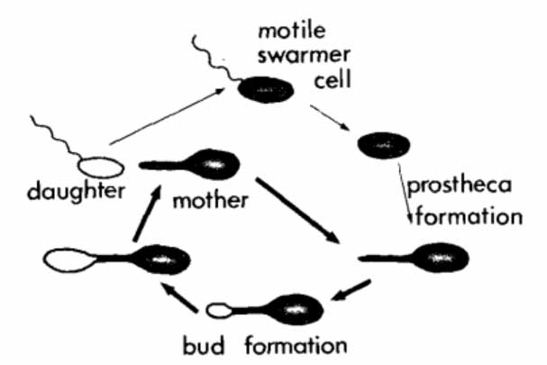
Hyphomicrobium
Sticks to surfaces; grows only on C1 and C2 compounds. Reproduce by budding
Grow on methanol and methylated amines but not methane
Hans van Dijken and Wim Harder 1973
Hyphomicrobium, Yeast and Growth yields of methylotrophs
Hirsch & Conti, Harder, Dow, Attwood.
Quayle (assimilation pathways)

Slide 5
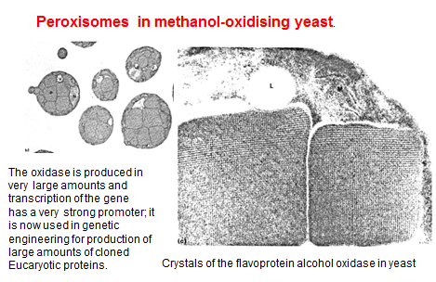
Methylotrophic Yeasts
By contrast with bacteria, the methylotrophic yeasts are not a special group; they are in the usual genera of yeasts [Hansenula, Candida, Pichia and Torulopsis]. Only 7/39 genera grow methylotrophically. They grow only on methanol (not methylamines or methane). Again, by contrast with bacteria they all share the same assimilation pathways.
They oxidise methanol by a flavoprotein alcohol oxidase coupled to catalase which is present in crystalline form in peroxisomes and which yields no energy. Almost all bacteria use an energy-yielding quinoprotein methanol dehydrogenase. all
1969-1975
Ogata, Tani, Sahm, van Dijken, Harder,
Quayle (assimilation)

Slide 6
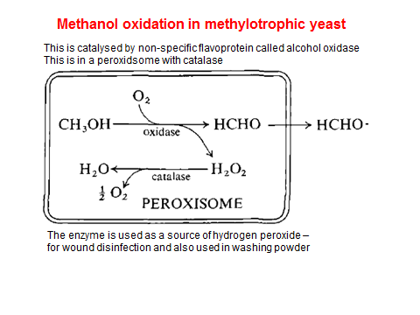

Slide 7

J. Guis Kuenen and Professor Kato (Tottori and Kyoto

Slide 8
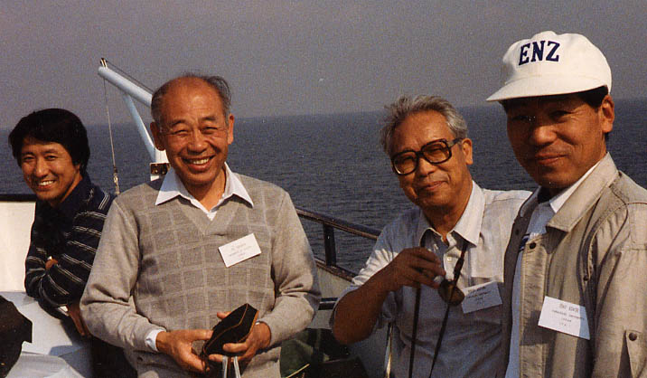
Friends from Yamaguchi, Japan: Matsushita, Uragami (?), Ameyama, Adachi

Slide 9
The main ‘groups’ of bacterial methylotrophs
Methanotrophs. Vast majority are obligate. (Recent important exceptions)
All have internal membranes and produce spores. Gram negative.
Type I (eg Methylococcus, Methylomonas) use RuMP pathway
Type II (eg Methylosinus, Methylocystis) use Serine pathway
Methylotrophs not using methane. None have internal membranes or produce spores. Vast majority are Gram negative.
Obligate methylotrophs Grow on methanol and/or methylamine. Gram negative, motile, non-sporing. Use RuMP pathway. Eg Methylophilus
Facultative methylotrophs. Usually grow on methanol/methylamine; use serine pathway
Pink facultative methylotrophs. Motile, single polar flagellum. Red carotenoids similar to photosynthetic bacteria. Wide range of C substrates but few carbohydrates. Methylobacterium
Non-pigmented facultative ‘pseudomonads’. No typical pseudomonas sp use C1 compounds.
Pseudomonas aminovorans. Use serine pathway (icl⁺ variant)
Gram-negative or variable non-motile rods. Some only use methylated amines. A mixed group. Eg
Arthrobacter.
Facultative autotrophs or phototrophs Use RuBP pathway (Calvin cycle). Paracoccus denitrificans
(can use hydrogen); Rhodopseudomonas
Gram positive facultative methylotrophs Very rare. Bacillus, Streptomyces
Hyphomicrobia Restricted facultative methylotrophs. Stalked. Budding. Serine pathway

Slide 10
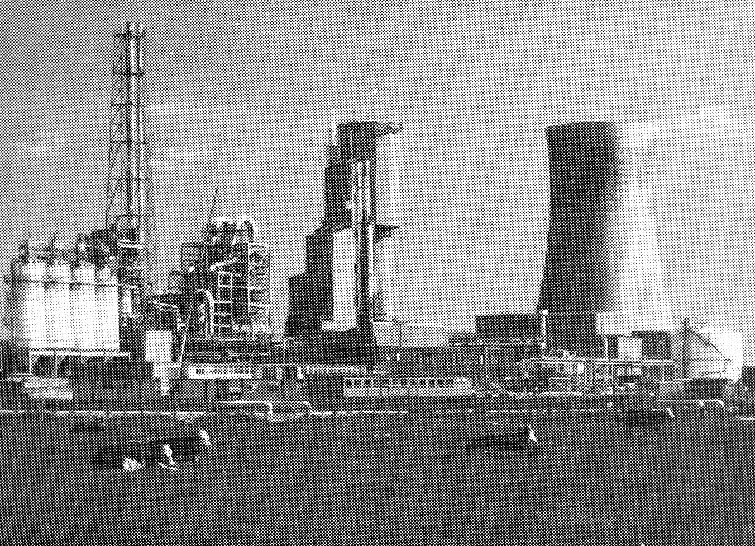
The ICI ‘Pruteen’ plant at Billingham, UK 1980
The centre tower is the 1.5 million litre fermenter
It contains about 100,000,000,000,000,000,000 methylotrophs
10% of their soluble protein is Methanol dehydrogenase

Slide 11
The Methylotrophs and their biochemistry as was known up to 1981 is covered comprehensively in
The Biochemistry of Methylotrophs by Cbris Anthony
It can be downloaded complete and free as a pdf file from my website
www.chris-anthony.co.uk
On this page: http://www.chris-anthony.co.uk/methylotrophs.html

Slide 12
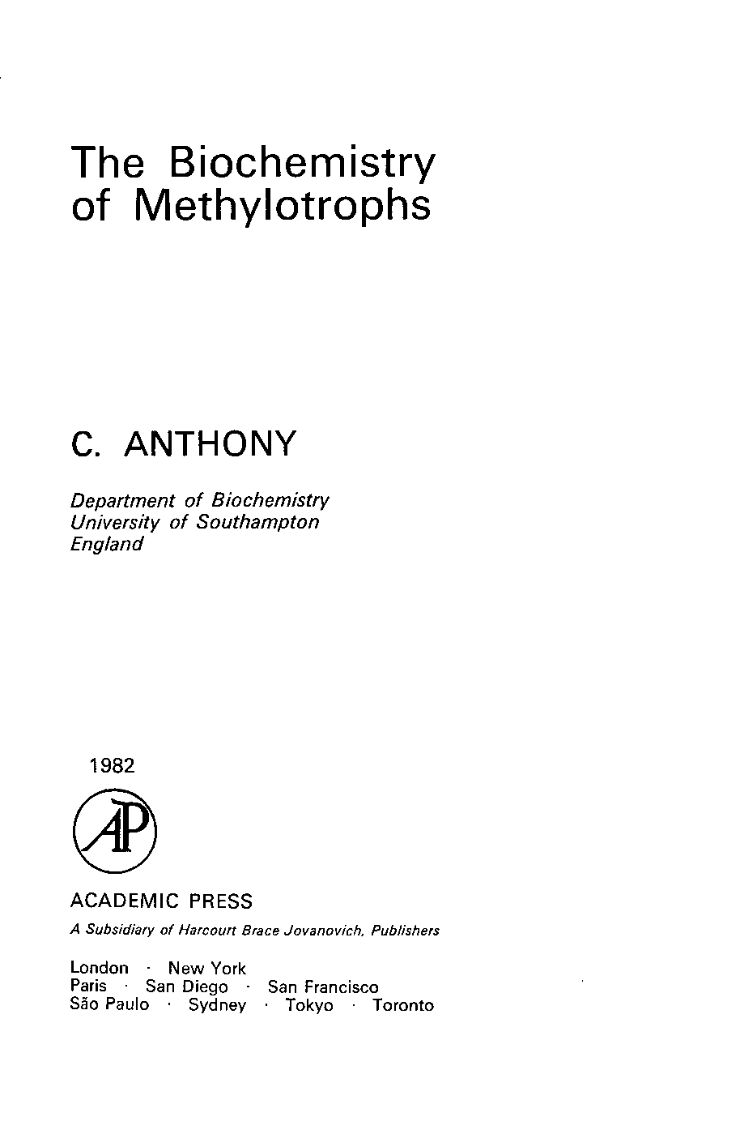
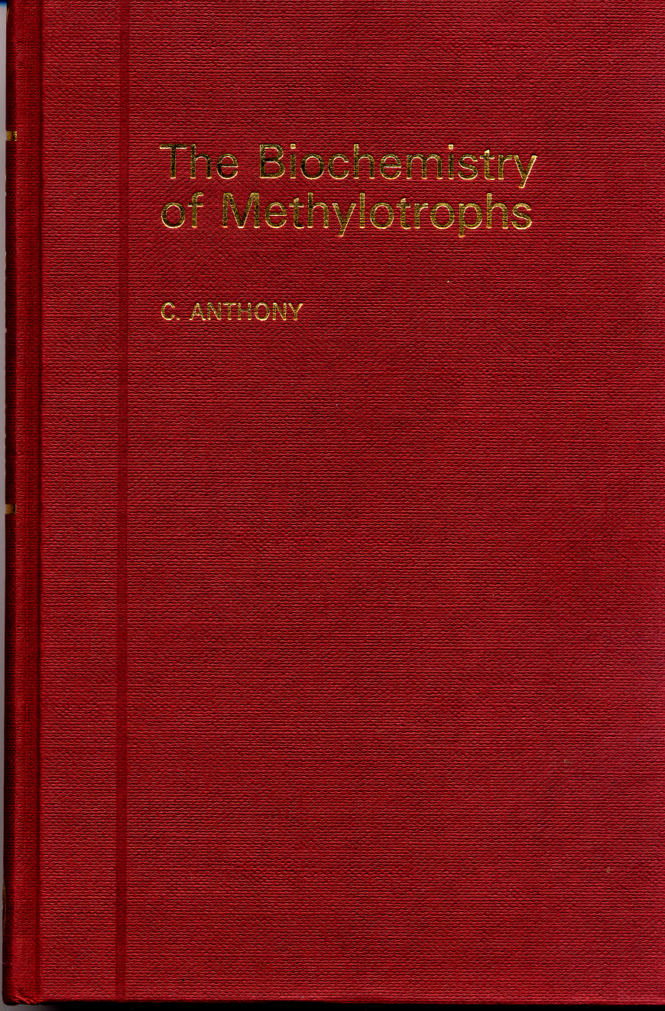
The Biochemistry of Methylotrophs 1982
Methylotrophic bacteria
Ribulose bisphosphate pathway
Ribulose monophosphate cycle
The Serine pathway
The TCA cycle and growth
on multicarbon compounds
Oxidation of methane, methanol,
formaldehyde and formate
Oxidation of methylated amines
Electron transport and
energy transduction
Growth yields and bioenergetics
Methylotrophic yeasts
Methanogens and
methanogenesis
Commercial exploitation
Chapters 12
Text pages 350
Index 48 pages
Tables 60
Figures 57
References 1300
A CD version is available and the complete book
is on my website: chris-anthony.co.uk

Slide 13
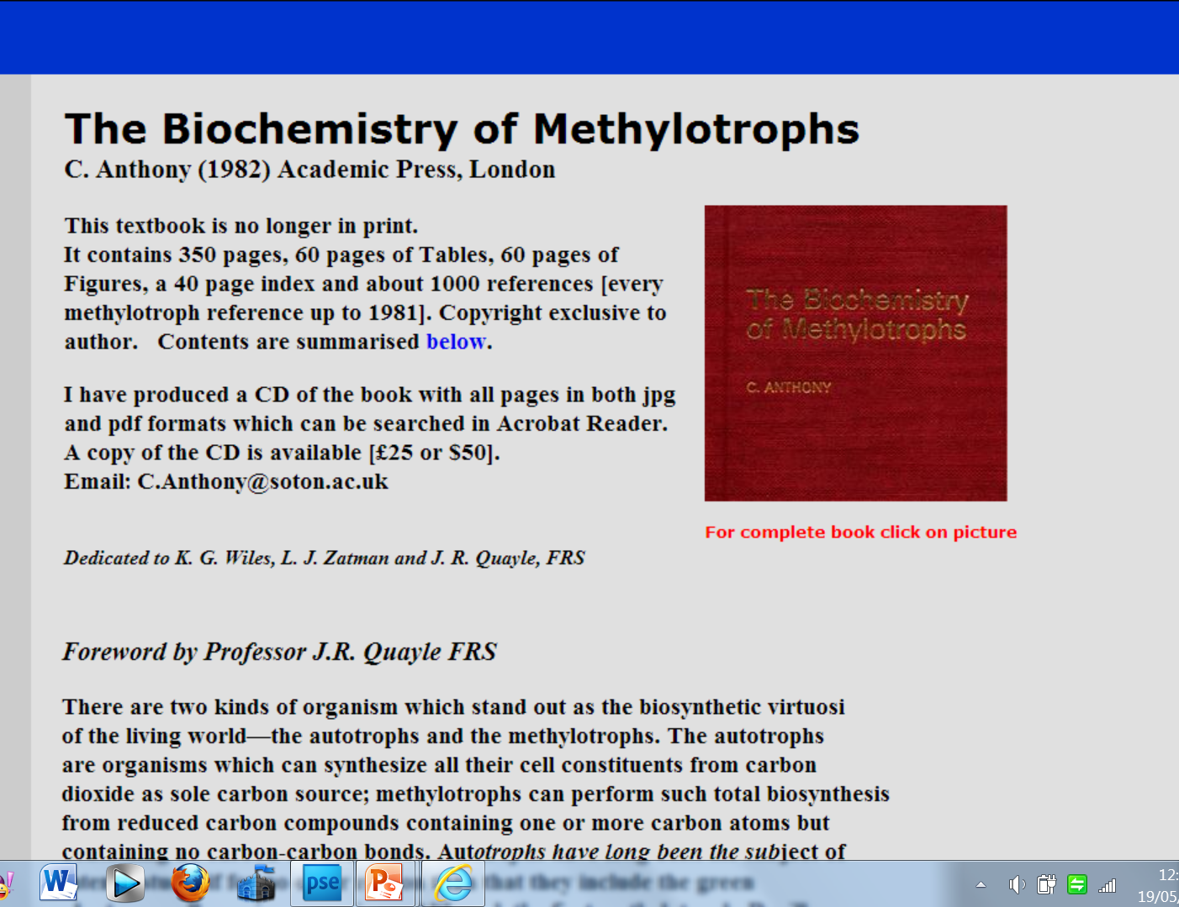
Click on book ot download it complete (free). Or ask for CD (free)

